Slide 1
109 Data Structure the 3rd Homework

Slide 2
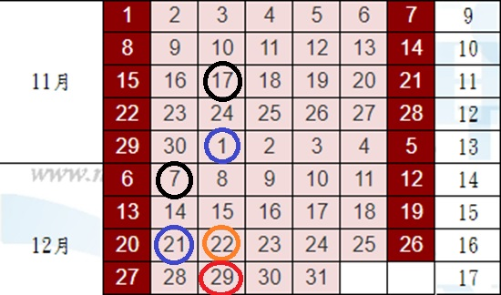
黑圈：HW3的開始與結束
藍圈：HW4的開始與結束
橘圈：第二次小考
紅圈：上機考
1/5：期末考

Slide 3
A Sad Teaching Assistant (40%)
There’s a teaching assistant for a data structure course in a university.
One day, the students told him that the homework he proposed is an algorithm-like homework. It’s not a homework for a data structure course.
He was depressed. Thus, he decides to propose a homework which is really associated to data structure.
Finally, the TA I just talked about is not me.

Slide 4
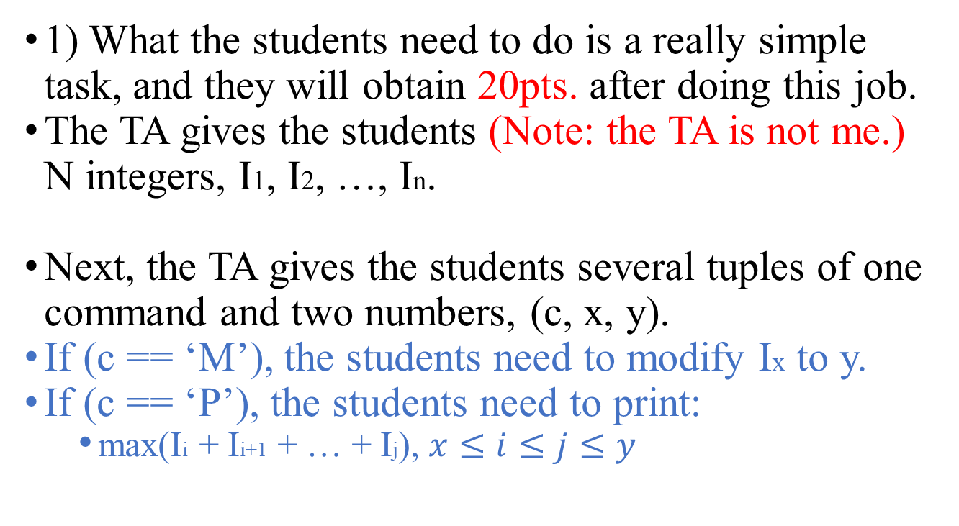
A Sad Teaching Assistant (40%)
1) What the students need to do is a really simple task, and they will obtain 20pts. after doing this job.
The TA gives the students (Note: the TA is not me.) N integers, I1, I2, …, In.
Next, the TA gives the students several tuples of one command and two numbers, (c, x, y).
If (c == ‘M’), the students need to modify Ix to y.
If (c == ‘P’), the students need to print:
max(Ii + Ii+1 + … + Ij), $x≤i≤j≤y$

Slide 5
A Sad Teaching Assistant (40%)
Input:
Line 1: An integer T, indicates how many times the task will be asked for.
Line 2: An integer N, indicates the number of the integers TA will give.
Line 3: N integers, I1, I2, …, IN, indicate the initial numbers.
Line 4: An integer M.
Next M lines: C x y tuples
Output:
For each P x y tuple, you need to print
max(Ii + Ii+1 + … + Ij)

Slide 6
A Sad Teaching Assistant (40%)
For example:
1 (T)
5 (N)
1 2 -100 3 4
5 (M)
P 1 5 // print 7 (3+4 = 7)
P 1 2 // print 3 (1+2 = 3)
M 3 5 // modify the integers into 1 2 5 3 4
P 1 5 // print 15 (1+2+5+3+4 = 15)
P 2 4 // print 10 (2+5+3 = 10)
output : 7\n3\n15\n10\n (\n : EOL)

Slide 7
A Sad Teaching Assistant (40%)
For this problem:
The times of the task might be asked for is T.
1 <= T <= 5
The number of integers given is N.
1 <= N <= 50000
The given integers are [-10000, 10000]
The number of command tuples given is M.
1 <= M <= 50000
Time limit: 2 second per data.

Slide 8
A Sad Teaching Assistant (40%)
Hint: You should make sure every command could work within time complexity O(log n).

Slide 9
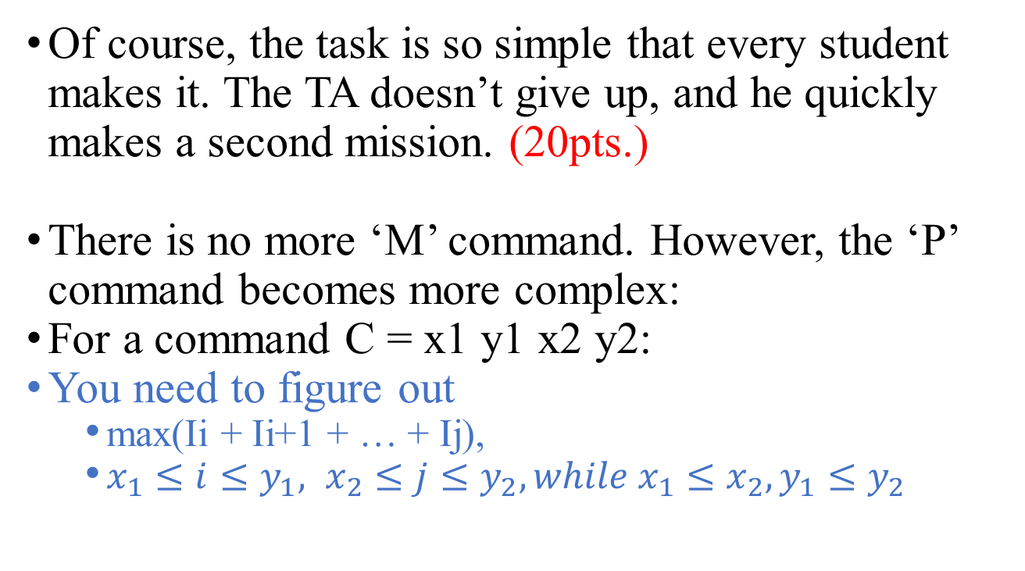
A Sad Teaching Assistant (40%)
Of course, the task is so simple that every student makes it. The TA doesn’t give up, and he quickly makes a second mission. (20pts.)
There is no more ‘M’ command. However, the ‘P’ command becomes more complex:
For a command C = x1 y1 x2 y2:
You need to figure out
max(Ii + Ii+1 + … + Ij),
$x_{1}≤i≤y_{1}, x_{2}≤j≤y_{2}, while x_{1}≤x_{2},y_{1}≤y_{2}$

Slide 10
A Sad Teaching Assistant (40%)
Input:
line 1: An integer T, indicates how many times the task will be asked for.
line 2: An integer N, indicates the number of the integers TA will give.
line 3: N integers, I1, I2, …, IN, indicate the initial numbers.
line 4: An integer M.
next M lines: x1 y1 x2 y2 tuples.
Output:
For each P x y tuples, print
max(Ii + Ii+1 + … + Ij)

Slide 11
A Sad Teaching Assistant (40%)
For example:
2 (T)
6 (N)
5 -9 -5 9 -3 4
3 (M)
1 3 6 6 // print 5 ((-5) + 9 + (-3) + 4 = 5)
1 2 3 6 // print 1 (5 + (-9) + (-5) + 9 + (-3) + 4 = 1)
4 4 6 6 // print 10 (9 + (-3) + 4 = 10)
6 (N)
-2 -7 8 9 9 -5
1 (M)
6 6 6 6 // print -5 ((-5) = (-5))
output : 5\n1\n10\n-5\n (\n : EOL)

Slide 12
A Sad Teaching Assistant (40%)
For this problem:
The task will be asked for T times.
1 <= T <= 5
The number of given integers is N.
1 <= N <= 10000
The given integers are [-10000, 10000]
The number of given command tuples is M.
1 <= M <= 10000
Time limit: 2 second per data.

Slide 13
Morse Code (60%)
Morse code is a method used to encode text characters as sequences of dots and dashes.
字元 | 代碼 | 字元 | 代碼 | 字元 | 代碼 | 字元 | 代碼
A | .- | H | .... | O | --- | V | ...-
B | -... | I | .. | P | .--. | W | .--
C | -.-. | J | .--- | Q | --.- | X | -..-
D | -.. | K | -.- | R | .-. | Y | -.--
E | . | L | .-.. | S | ... | Z | --..
F | ..-. | M | -- | T | -
G | --. | N | -. | U | ..-

Slide 14
Morse Code (60%)
You receive confidential documents. Your supervisor used Morse code to encode the contents.
However, there are no spaces separating the letters in the documents.
Therefore, there may be several interpretations of any single decoded sequence.
For example:
“-....--.-.” could be: “DUC”, “DUTETE”, “BAC”, “BANN”, ...

Slide 15
Morse Code (60%)
You try to decode the contents of the documents. Because there are too many documents, you decide to write a program to help you.
It’s hard for a machine to recognize which interpretation is reasonable. Thus, you use a dictionary to support this task.

Slide 16
Morse Code (60%)
1) English dictionary to Morse code. (15%)
Input:
line 1: An integer N, indicates the number of words in the dictionary.
next N lines: A word.
line N+2: An integer M.
next M lines: a sequence of dots and dashes.
Output:
For each sequence, you need to print:
It is found in the dictionary.
It is not found in the dictionary.

Slide 17
Morse Code (60%)
For example:
4 (N)
APPLE // .-.--..--..-...
BANANA // -....--..--..-
CAT // -.-..--
DOG // -..-----.
2 (M)
-.-..-- //printf(“-.-..-- is found in the dictionary.\n”)
-.- //printf(“-.- is not found in the dictionary.\n”)

Slide 18
Morse Code (60%)
2) Determine if two words have the same prefix. (15%)
Input:
line 1: A word w1.
line 2: An integer N.
next N lines: A word w2.
Output:
For each w2, you need to determine:
After w1, w2 are both encoded into Morse code:
w2 is the same as w1.
w2 has the same prefix as w1.
w2 doesn’t have the same prefix as w1.

Slide 19
Morse Code (60%)
For example:
CAT (w1) // -.-..--
3 (M)
NDTT // -.-..--
KIT // -.-..-
RUT // .-...--
output:
“NDTT is the same as CAT.”
“KIT has the same prefix as CAT.”
“RUT doesn’t have the same prefix as CAT.”

Slide 20
Morse Code (60%)
3) With the dictionary and the program, you only need to check the part of the interpretations. (30%)
Input:
line 1: A Morse sequence with a maximum length L.
line 2: An integer N indicates the number of words in the dictionary.
next N lines: One word.
Output:
The number of messages R, which are possible to generate with the Morse sequence and the dictionary.

Slide 21
Morse Code (60%)
For example:
......-...-..---.-----.-..-..-..
5
HELL // ......-...-..
HELLO // ......-...-..---
OWORLD // ---.-----.-..-..-..
WORLD // .-----.-..-..-..
TEST // -....-
output: 2 (HELL+OWORLD, HELLO+WORLD)

Slide 22
Morse Code (60%)
The Morse sequence has a maximum length L.
0 < L < 100000
The number of words in the dictionary is N.
0 < N < 100000
The words in the dictionary have a maximum length M.
0 < M < 20
Time limit: 2 second per data.

Slide 23
Reminders
For all of the question, please read test.txt as input and write output.txt as output.
對於所有問題，請都讀test.txt作為input、寫output.txt作為output
If you can, please let me know how to change your I/O file name so that I can modify the path from test.txt to test1.txt, test2.txt, etc.
假如可以的話，讓我清楚知道從哪裡更改你I/O檔案的名稱，方便我可以從讀test.txt改成讀test1.txt, test2.txt，會改得比較快。
如果我看不懂，那我不會改你的code，一律讀test.txt。

Slide 24
Reminders
Only accept C
Deadline : 2020/12/07 23:59, please be on time.
File name : [student ID]_[question No.(1or2)]-[sub question No.(1,2,3)].[file name extension]
e.g. 7109056193_1-1.c
If there are more than 1 file for 1 question, please give a readme.txt for me and let me know the meaning of each file.
No need to give me the output, I’ll execute your program.
Zip all your files and hand in on the i-learning, the file name is [student ID]_homework3.
Plagiarism is prohibited.
Dev-C++ 5.11 is used for checking this homework.

